Slide 1


Testing a New Release Every 3 mins
Petr Chytil
AVAST Software a.s.

Slide 2
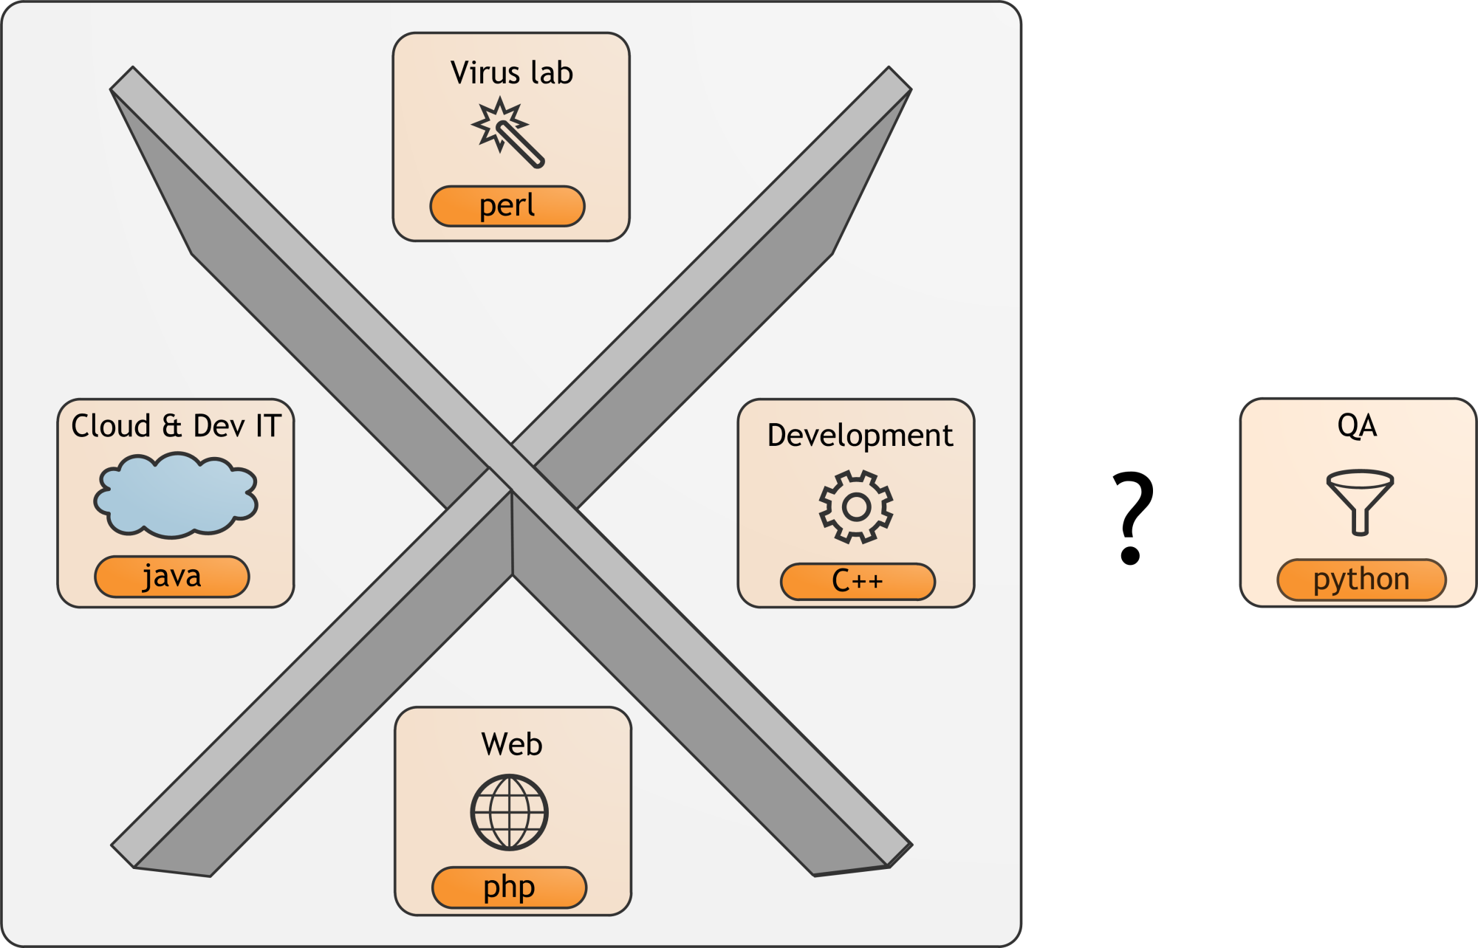
Department map in Avast

Slide 3
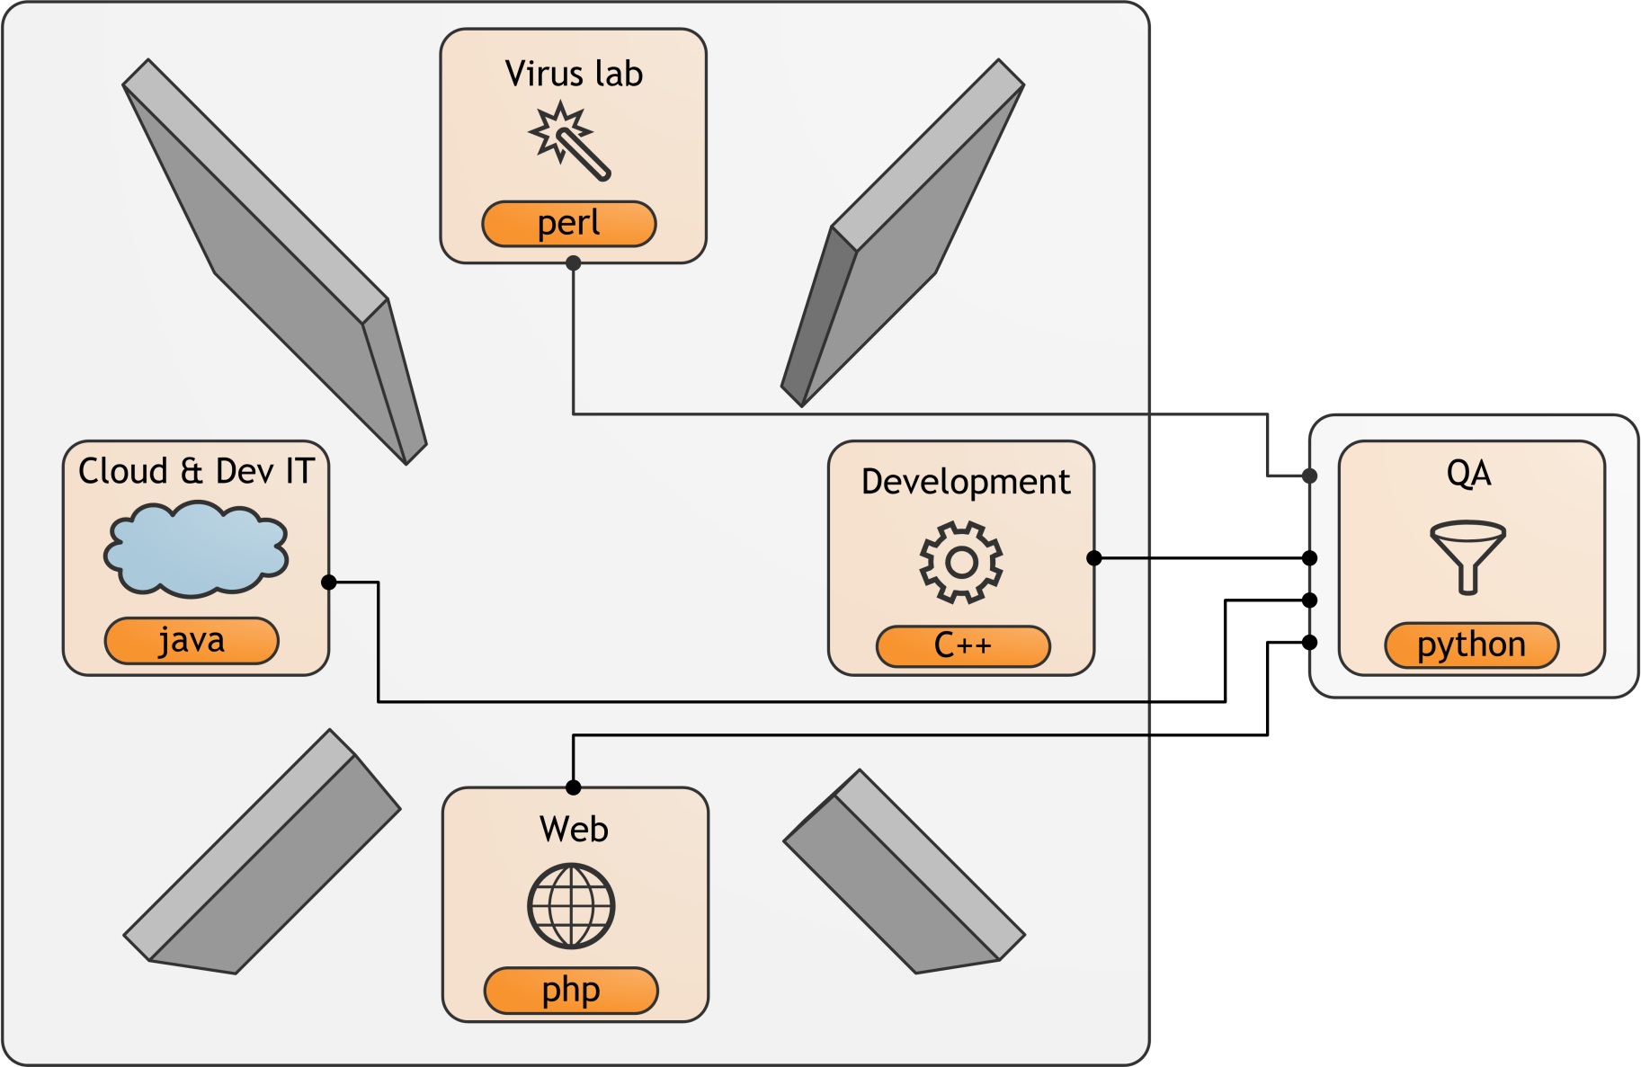
Department map with QA dept.

Slide 4

Malware x AntiVirus Arms Race

Slide 5
Getting Updates from the Cloud
AVAST Streaming Updates
Pushing new virus definitions to clients continuously
Hybrid solution, clients still pull two or three virus definitions during the day
Virus definition generation:
Fully automated
10 engines, 5 for streaming updates
Community based
Backend:
High performance Java application, 40 millions concurrent connections

Slide 6
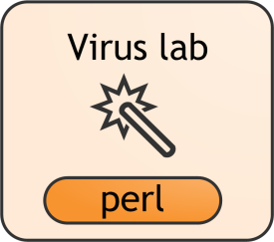


distribution
The Cloud
Virus definition
Package
Delivery

Slide 7
The Backend
40 millions concurrently connected users
2 millions connections per server in peak

Slide 8
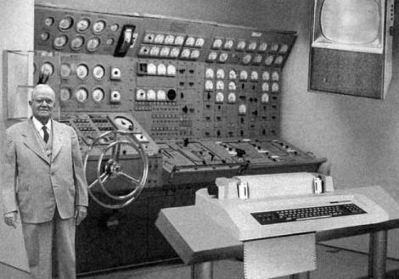
Testing The Cloud
Every streaming update has to be tested
Integrate smoke tests into existing viruslab infrastructure
Build infrastructure implemented in perl
Every 3-5 minutes, small package of virus definitions is distributed to over 200 million users
But, do not break their computers

Slide 9
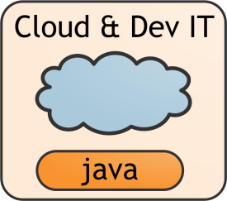
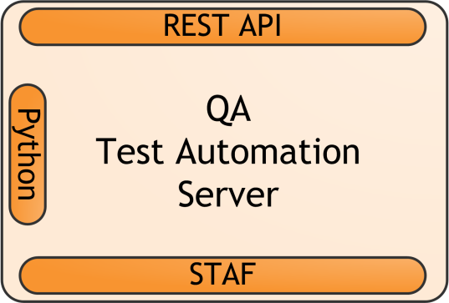
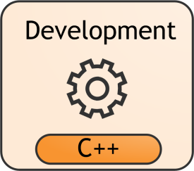
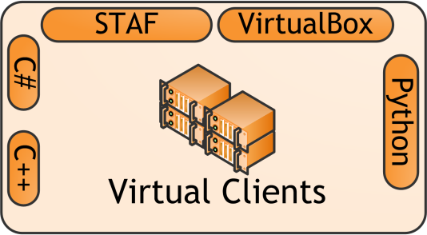
Test Automation Server
Virus definition release
Job execution
Job result
Test execution
Job execution
Test result
Job result
Server backend testing
Virus definition testing
Functional test execution
Test execution
Test result
VM Control

Slide 10

Jenkins – Test Automation Server
Centerpiece of our testing infrastructure
We use Jenkins CI
An extendable open source continuous integration server
Runs and monitors repeated jobs, e.g. builds software projects
Main features:
Quick setup and configuration
Test results reporting, archiving
File fingerprinting
Tons of existing plugins
And much more

Slide 11
The Cloud - solution
Functional (or integration?) tests implemented in C#
Tests have to be 100% reliable …
The environment: Windows OS guests in VirtualBox
Remote test execution using STAF framework
Integration of Jenkins job into the perl build script using Jenkins REST API

Slide 12
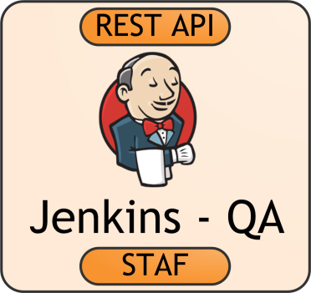


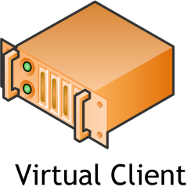
The Cloud
OK?
Test execution
Test result
Virus definition release
Virus definition release
Package
Delivery
Package delivery
Test execution
Test result

Slide 13
Conclusion
Even integration tests can be:
Fast
Reliable
Fully automated
Do not take “it cannot be tested” as an answer

Slide 14
Questions and Answers
Contact info
Petr Chytil chytil@avast.com

Slide 15
Appendix - Technologies
Jenkins http://jenkins-ci.org/
Parametrized Trigger Plugin
Build Pipeline Plugin
Robot Framework Plugin
STAF http://staf.sourceforge.net/
VirtualBox https://www.virtualbox.org/
Sikuli http://www.sikuli.org/
Selenium http://www.seleniumhq.org/

